Slide 1

Twitter Sentiment Classification
Nick Gigliotti

Slide 2
Business Problem
Create an accurate predictive model that can classify novel tweets as expressing positive, negative, or neutral sentiment.
Find out what people are saying about Apple and Apple products at South by Southwest, 2011.
Make some PR recommendations for the period immediately following the event.

Slide 3
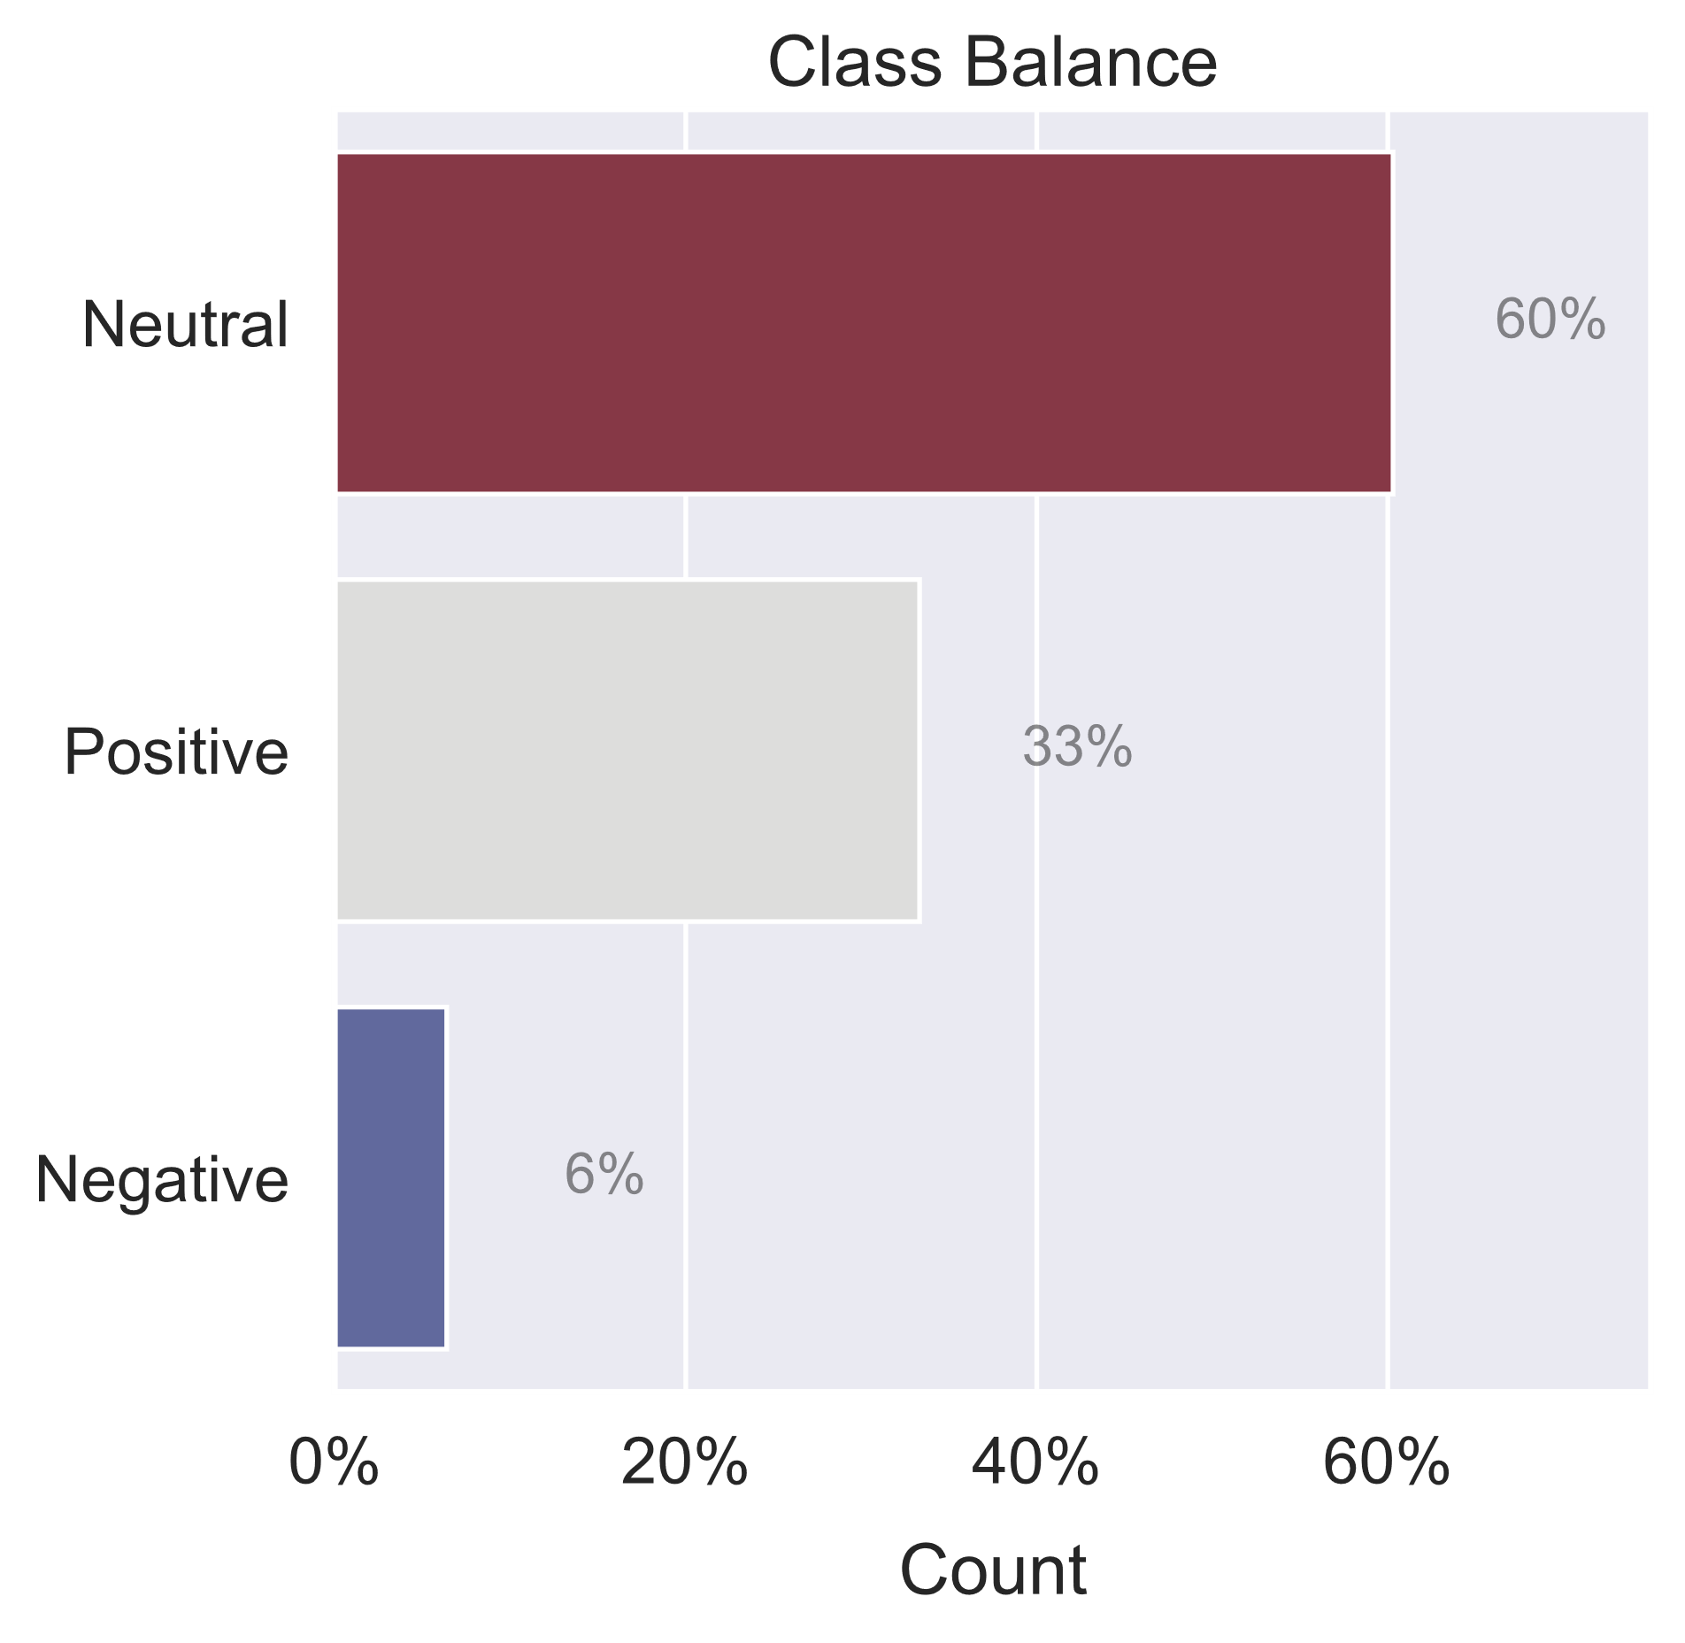
Dataset
Tweets related to South by Southwest, 2011
Annual conference and arts festival
Austin, TX
Major site for iPad 2 Launch
Crowdsourced sentiment labels
CrowdFlower
~9k tweets: just text and labels
Tweets are labeled with Positive, Negative, Neutral, or Uncertain
Tweets are labeled with brands and products related to the sentiment
Very sparse ‘Negative’ class
‘Uncertain’ class discarded

Slide 4

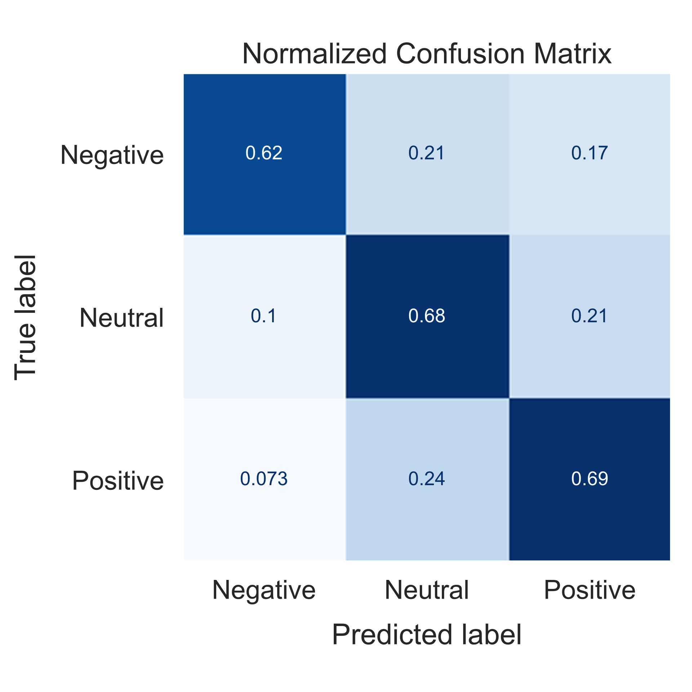
Methods and Model
Final Model Evaluation
Average of normalized diagonal
Unweighted
Weighted average of normalized diagonal
Weighted by class representation
Balanced Accuracy: 0.67
Accuracy: 0.68
Iterative Process
Logistic Regression
Relatively simple
Powerful
Widely used
Preprocessing
Filter text
Mark negated phrases
TF*IDF Vectorization
Term Frequency * Inverse Document Frequency
VADER Analysis
Valence Aware Dictionary and Sentiment Reasoner

Slide 5
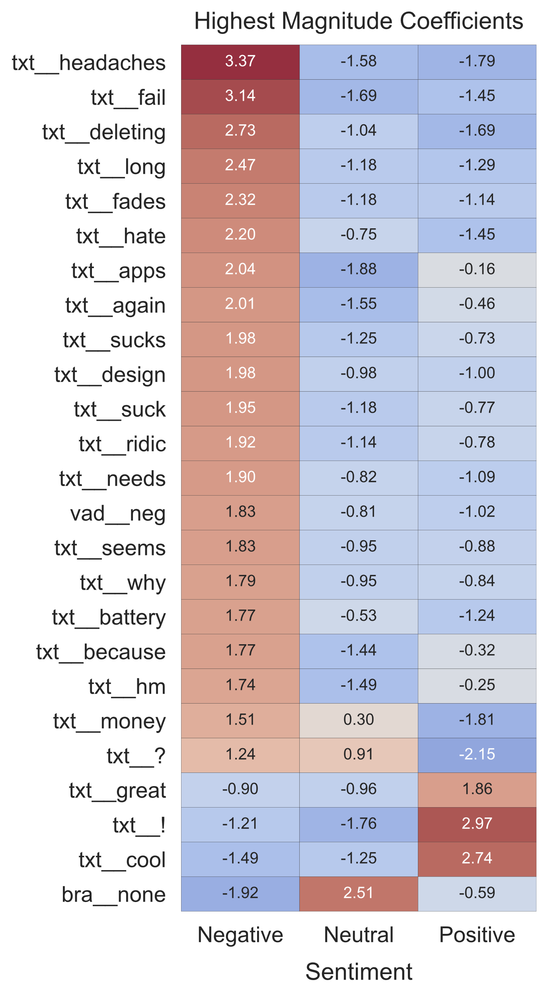
Most Important Features The Prefixes
TF*IDF words have the largest coefficients
The ‘Negative’ class has the largest overall
Having no brand terms is strongly related to ‘Neutral’
txt__
TF*IDF Words
bra__
Brand Terms
Extracted from each tweet and encoded as 1 or 0 for “present” or “absent”
vad__
VADER Polarity Scores
Scores from rule-based sentiment analysis used as features in the greater model
Algorithm scores each word relative to each tweet
Identifies the most important words in each tweet
“Apple”
“iPad”
“iPhone App”
More…
Valence Aware Dictionary and Sentiment Reasoner
Term Frequency $×$ Inverse Document Frequency
Term Frequency × Inverse Document Frequency

Slide 6
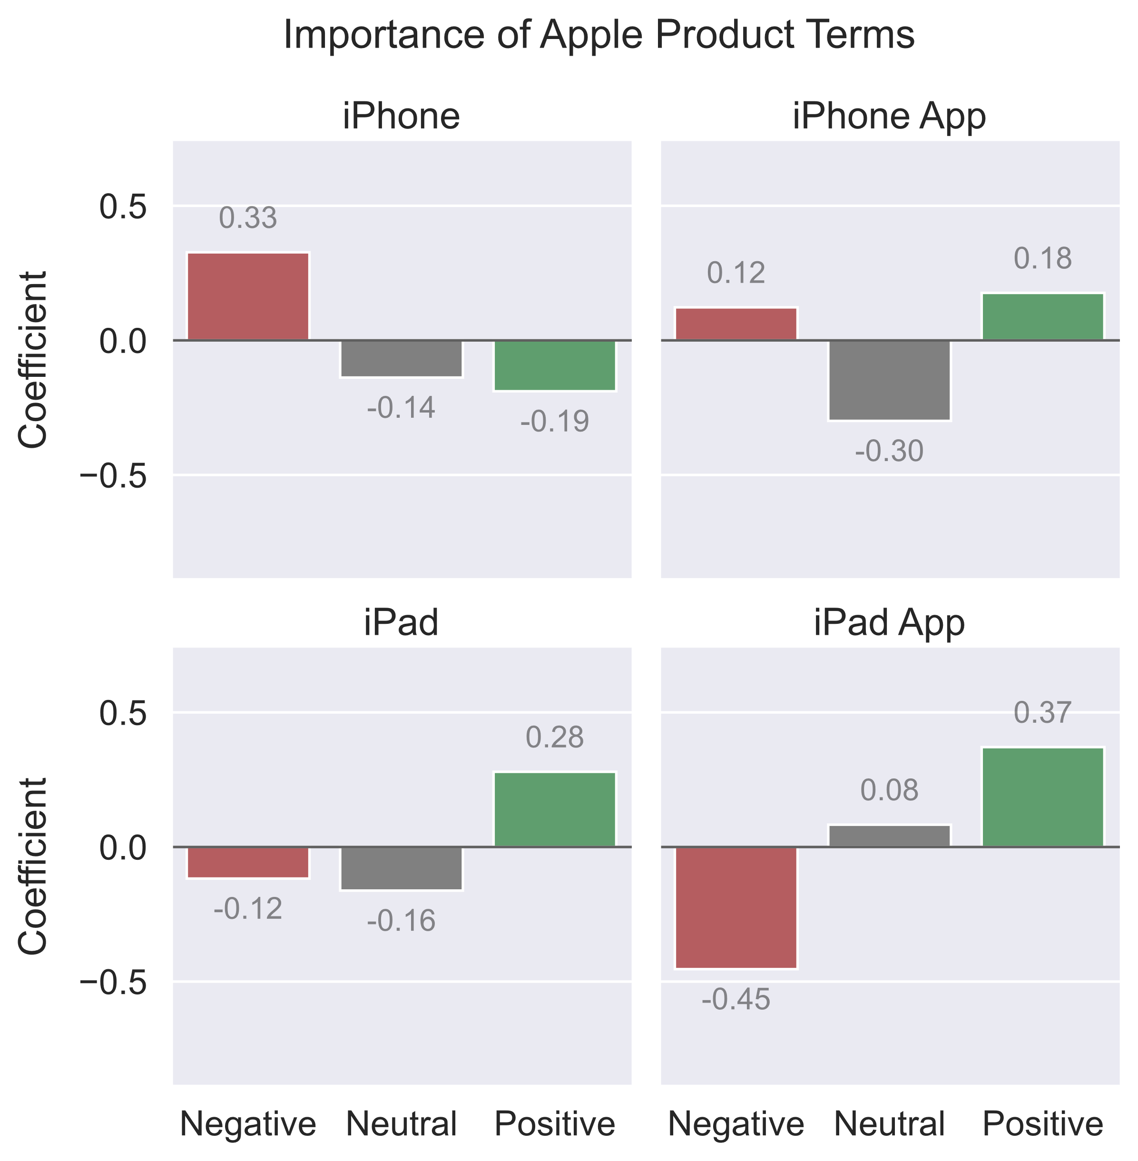
Brand Term Coefficients
‘iPhone’ has a negative trajectory.
‘iPad’ is related to the positive class.
‘iPad App’ has the strongest positive trajectory.
‘iPhone App’ has looks to be a controversial.
People are much more excited about iPads than iPhones.
Tweets from iPad 2 launch.
Recommendation:
Invest in the iPad development community and focus on developing iPad apps yourself.

Slide 7
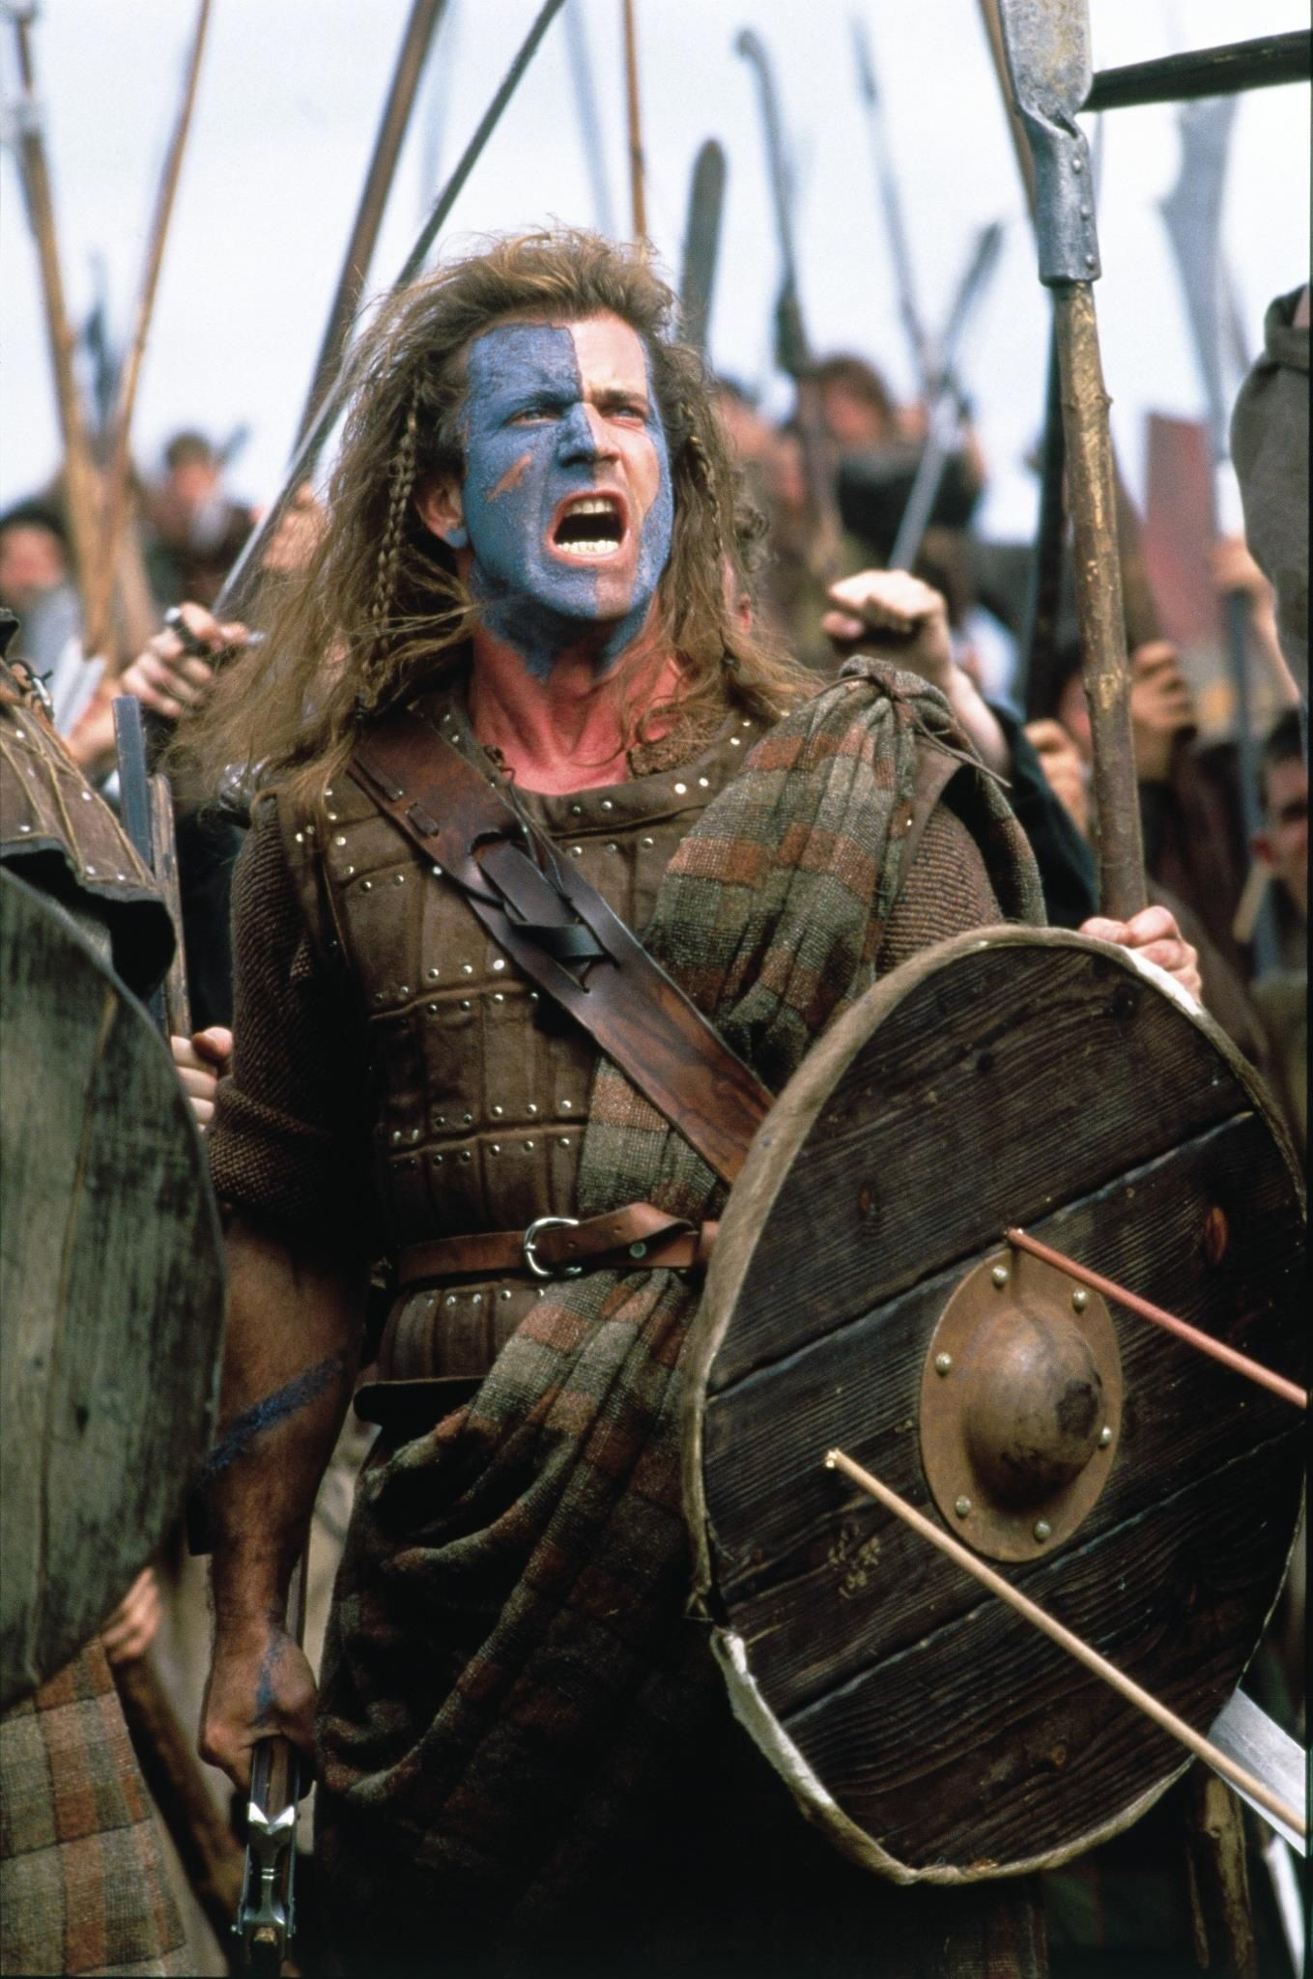
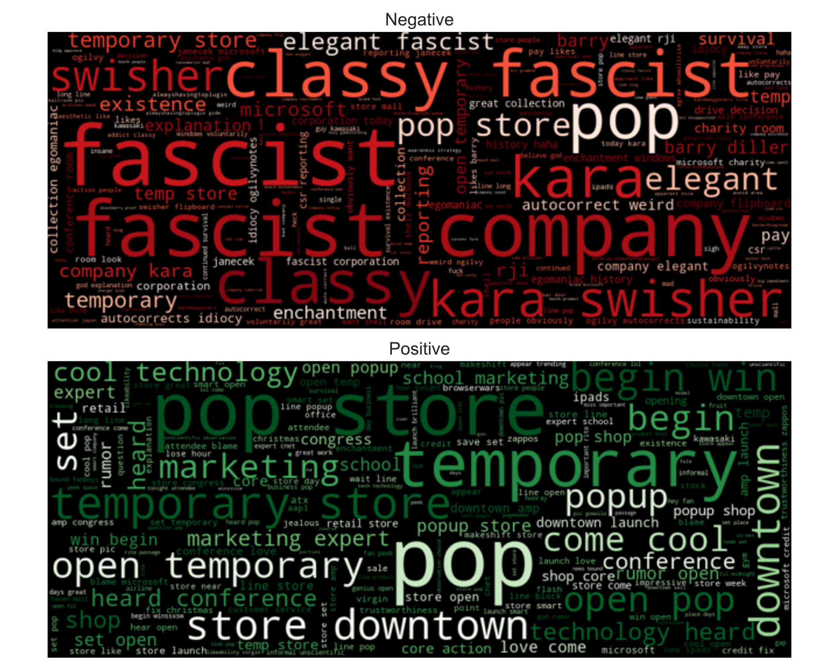
Freeeedom!
Recommendation:
Relinquish some control to send the message that people are free to use Apple’s products however they wish.
Apple is known for wanting total control of its products, even well after they leave the shelf.
The original comment was in response to the suggestion that Apple might create its own proprietary newsstand for e-magazines.
Flipboard: game-changer or just a fad? (2011)
At SXSW, Tech Reporter Kara Swisher called Apple “the classiest fascist company in America,” and it took off.
People were very excited about the “cool technology” at the pop-up store.

Slide 8
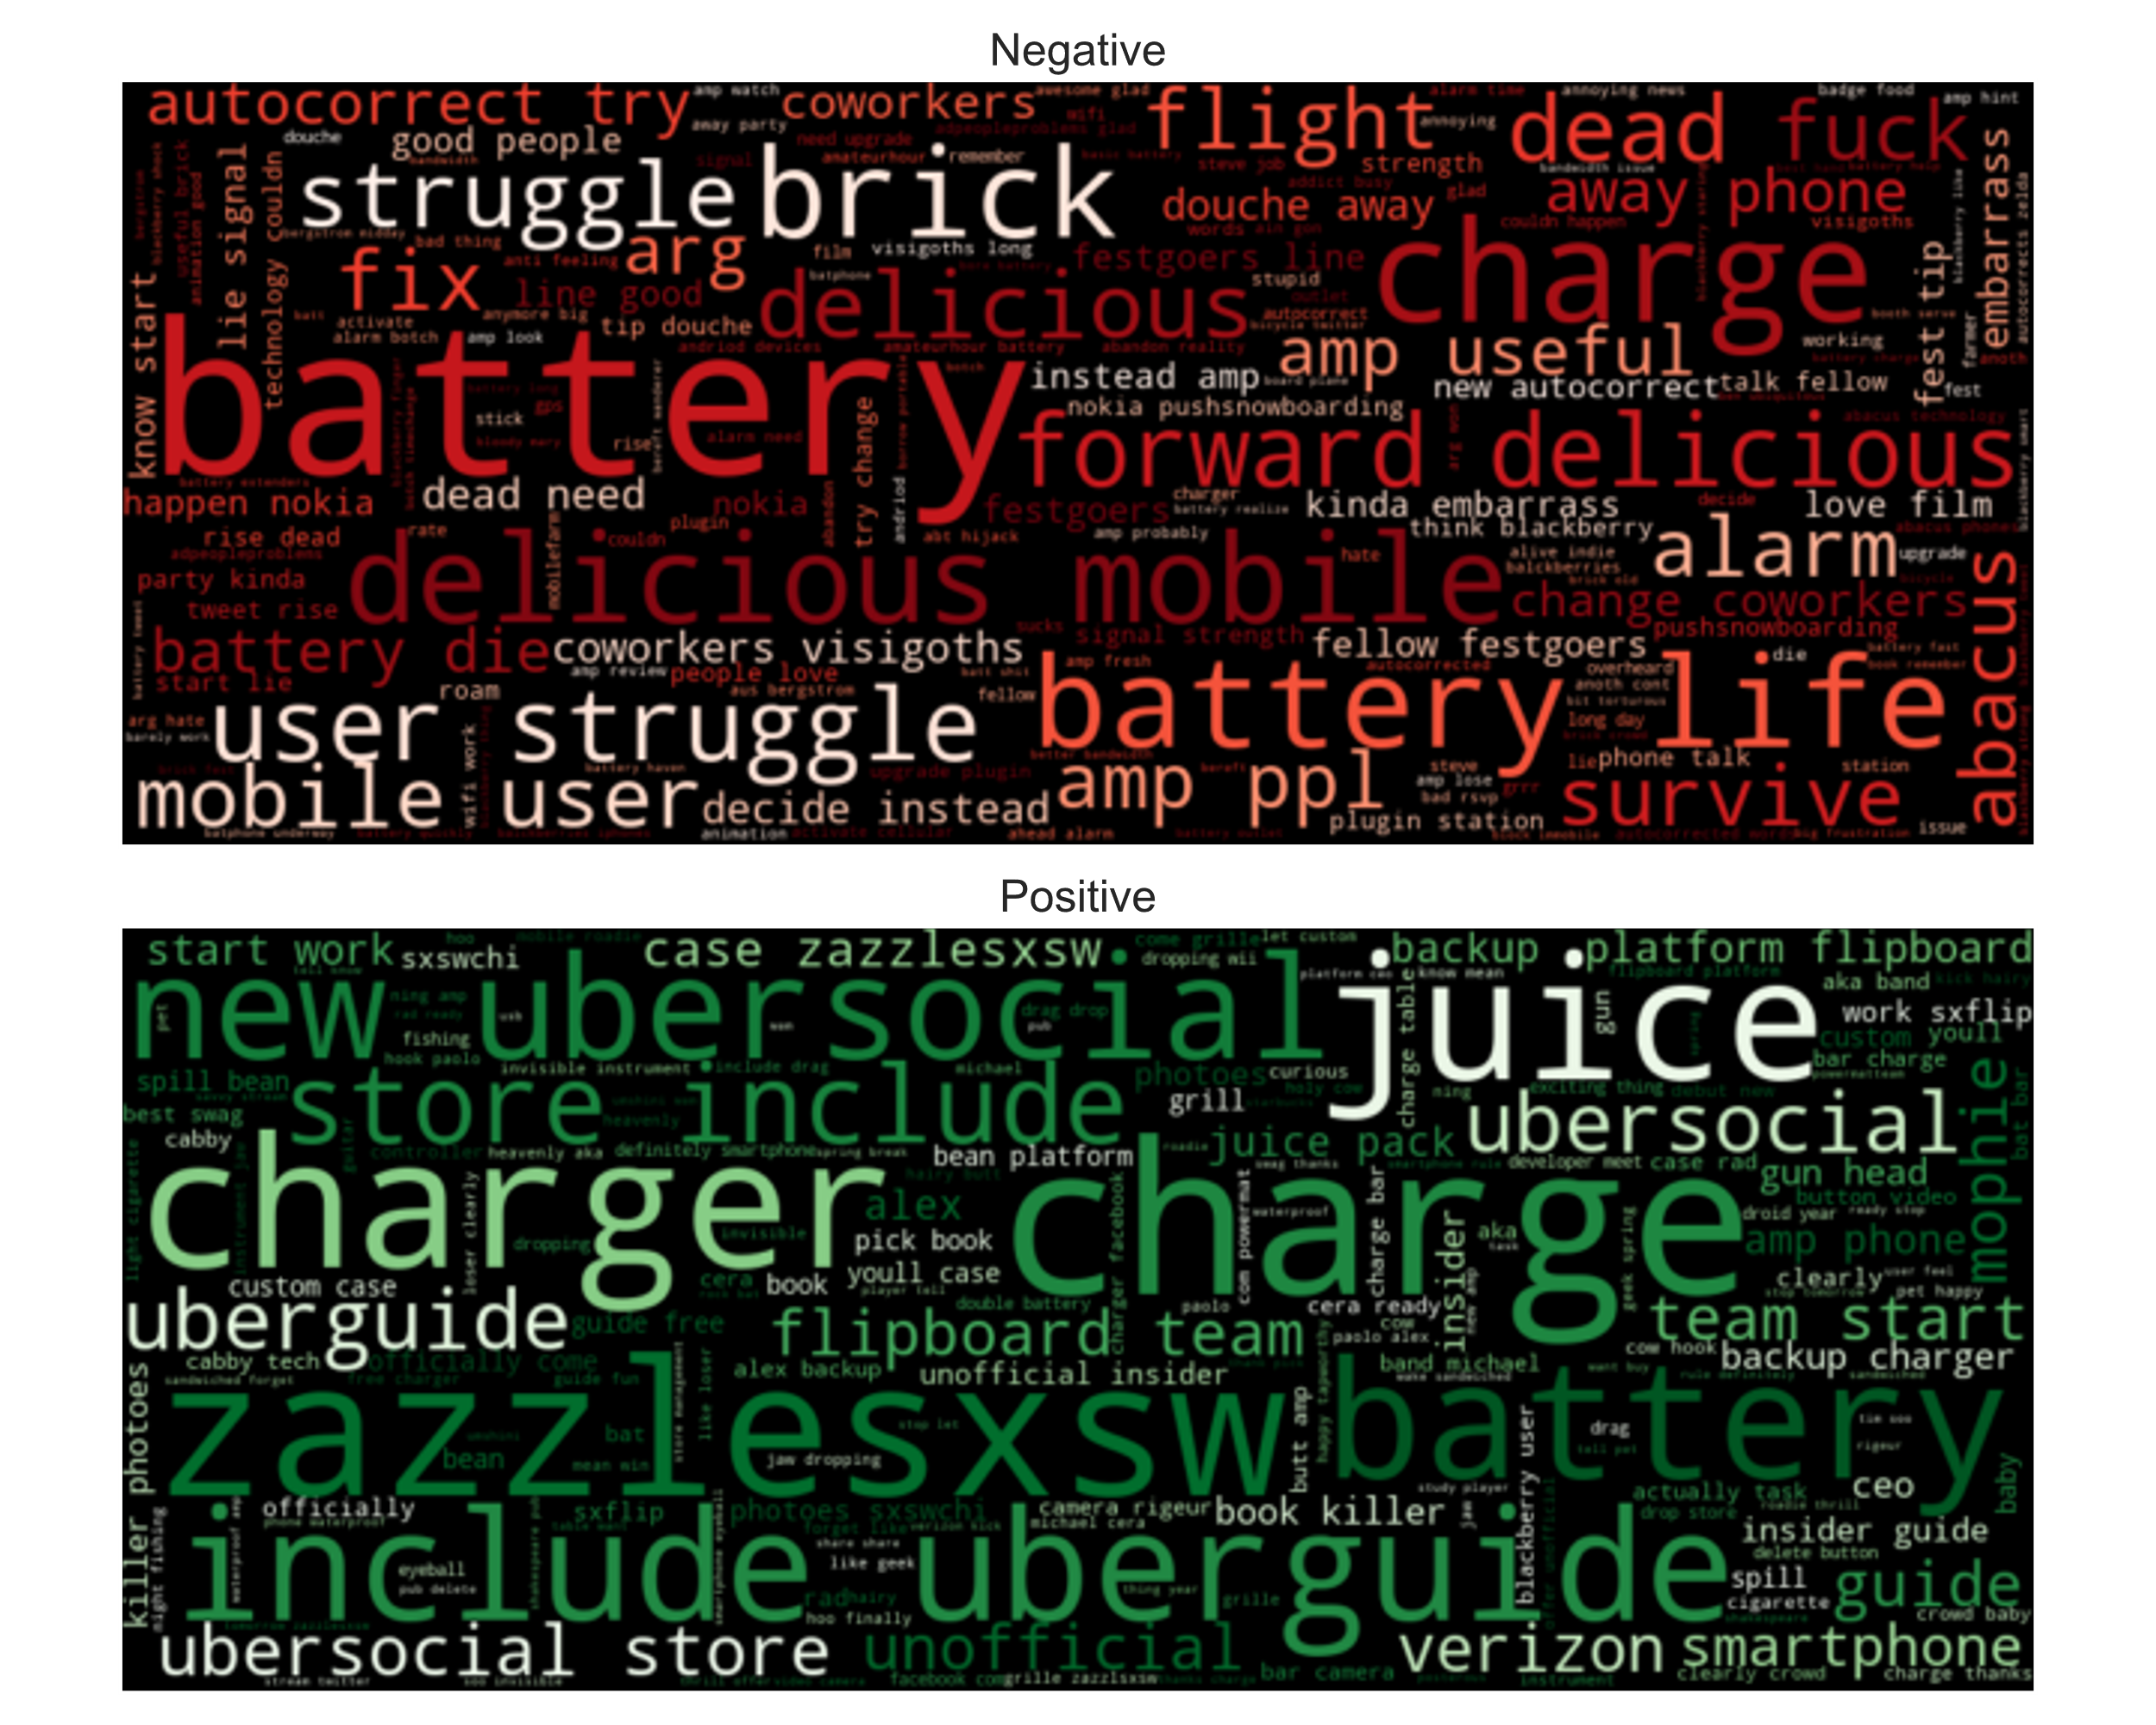
Complaints about iPhone Battery Life
Many people are complaining about the iPhone’s limited battery life.
Others are rejoicing at having a charger (see the positive word cloud).
Some people mocked the spotty AT&T service which many iPhone users have.
You already solved this problem by allowing Verizon to carry the iPhone.
Recommendation:
Improve the iPhone’s battery life and turn it into a new marketing campaign. People will pay attention to that.

Slide 9
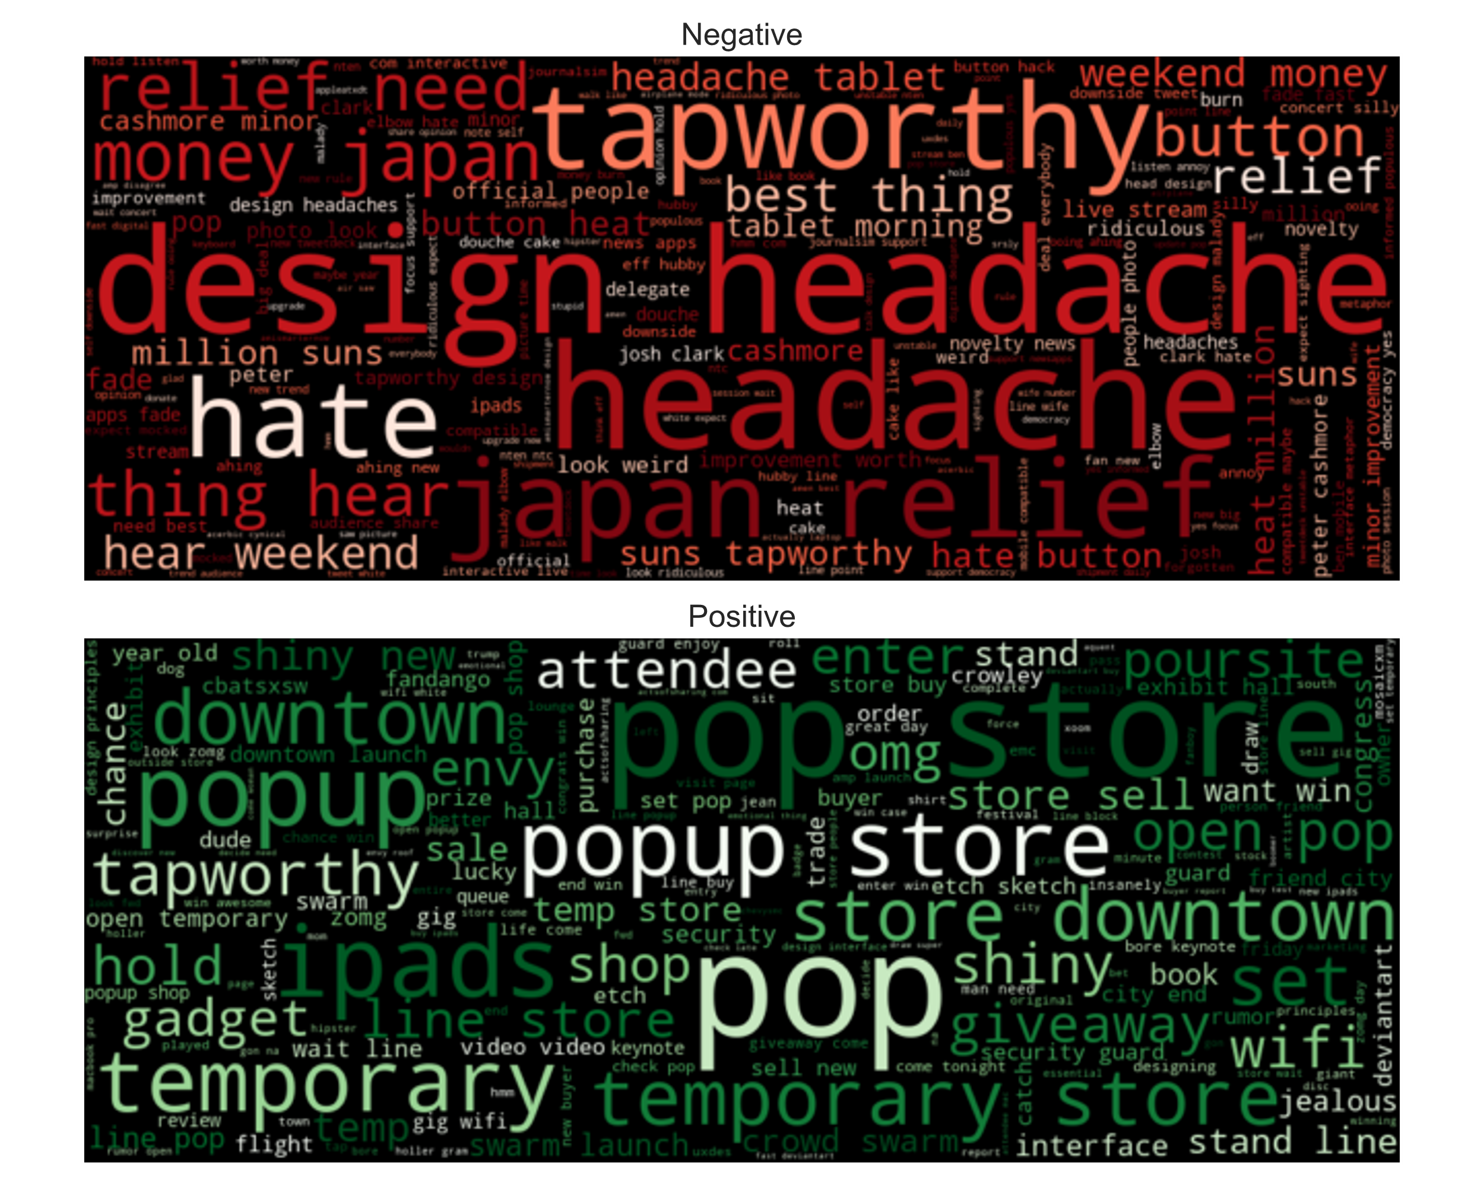

Slide 10

Conclusion
I built a reasonably accurate model (0.68) using logistic regression.
There is still room to improve the model.
I arrived at three recommendations:
Put more energy and resources into iPad app development (less into iPhone).
Send the message that Apple cares about individual freedom by relinquishing control in a public manner.
Improve the iPhone’s battery life and use it as a rallying point for a marketing campaign.

Slide 11

Future Work
Stacking Classifiers
Combine the results of multiple classifiers.
Increases accuracy and both positive and negative recall.
Sophisticated Vectorization
Use a Doc2Vec model trained on a large corpus of tweets.
Explore other sophisticated vectorization algorithms.

Slide 12
Thanks
Nick Gigliotti
ndgigliotti@gmail.com

